Slide 1
Understanding the philosophy of continuous improvement review (CIR) M Adil A Kazi
Identifying & addressing its challenges and its role in Re-accreditation process

Slide 2
Introduction to Accreditation life cycle & stakeholders management
NO
Yes
1- Formal Application
3- Eligibility Screening
4- Pre-Review Mentorship
5-Self Assessment Process
6-Peer Review Process
7-Accreditation Decision
2- Pre-Eligibility Mentorship
8-Continuous Review (Re-accreditation/ Revisit
NBEAC RE-ACCREDITATION FRAMEWORK
NBEAC Accreditation 8-Stages Process
Formal Application
Pre Eligibility Mentorship
Eligibility Screening
Pre Review Mentorship
Self-Assessment Process
Peer Review Process
Accreditation Decision
Continuous Review (Reaccreditation / Accreditation)

Slide 3
Introduction to Accreditation life cycle & stakeholders management
NO
Yes
1- Formal Application
3- Eligibility Screening
4- Pre-Review Mentorship
5-Self Assessment Process
6-Peer Review Process
7-Accreditation Decision
2- Pre-Eligibility Mentorship
8-Continuous Review (Re-accreditation/ Revisit
NBEAC RE-ACCREDITATION PROCESS
NBEAC Accreditation 8-Stages Process
Formal Application
Pre Eligibility Mentorship
Eligibility Screening
Pre Review Mentorship
Self-Assessment Process
Peer Review Process
Accreditation Decision
Continuous Review (Reaccreditation / Accreditation)
The NBEAC accreditation process enters into “Re-accreditation/ Revisit process cycle” as continuous function after completion of the PRT visit or accreditation award.
This embeds a dynamic function of continuous review process configuring Quality Enhancement regime to improve standards before the re-accreditation visit.

Slide 4
Introduction to Accreditation life cycle & stakeholders management
NO
Yes
1- Formal Application
3- Eligibility Screening
4- Pre-Review Mentorship
5-Self Assessment Process
6-Peer Review Process
7-Accreditation Decision
2- Pre-Eligibility Mentorship
8-Continuous Review (Re-accreditation/ Revisit
NBEAC RE-ACCREDITATION PROCESS
Post-Accreditation – Continuous Improvement Review
The School of Business after having acquired Accreditation from 3-5 years or otherwise communicated by NBEAC through official “Accreditation Decision/ Awarding Notification”
The notification carries:
Accreditation Award Committee Decision
PRT report with Recommendations & Suggestions Annex-I
Eligibility policy and timeline for re-acrrediation Annex-II
NBEAC Publicity Policy Annex-III

Slide 5
Introduction to Accreditation life cycle & stakeholders management
NO
Yes
1- Formal Application
3- Eligibility Screening
4- Pre-Review Mentorship
5-Self Assessment Process
6-Peer Review Process
7-Accreditation Decision
2- Pre-Eligibility Mentorship
8-Continuous Review (Re-accreditation/ Revisit
NBEAC RE-ACCREDITATION PROCESS
Post-Accreditation – Continuous Improvement Review
RECOMMENDED COURSE OF ACTION:
Engage internal stakeholders (Faculty & Management) and share high-level concerns

Slide 6
Introduction to Accreditation life cycle & stakeholders management
NO
Yes
1- Formal Application
3- Eligibility Screening
4- Pre-Review Mentorship
5-Self Assessment Process
6-Peer Review Process
7-Accreditation Decision
2- Pre-Eligibility Mentorship
8-Continuous Review (Re-accreditation/ Revisit
NBEAC RE-ACCREDITATION PROCESS
Post-Accreditation – Continuous Improvement Review
RECOMMENDED COURSE OF ACTION:
Engage internal stakeholders (Faculty & Management) and share high-level concerns
Constitution and formal establishment of permanent “Accreditation Management Committee”, at School of Business / Management Sciences:
Head AMC Experienced Faculty
Members Cluster Heads
Coopted Members Junior Faculty
QEC Dy Manager Secretary

Slide 7
Introduction to Accreditation life cycle & stakeholders management
NO
Yes
1- Formal Application
3- Eligibility Screening
4- Pre-Review Mentorship
5-Self Assessment Process
6-Peer Review Process
7-Accreditation Decision
2- Pre-Eligibility Mentorship
8-Continuous Review (Re-accreditation/ Revisit
NBEAC RE-ACCREDITATION PROCESS
Post-Accreditation – Continuous Improvement Review
RECOMMENDED COURSE OF ACTION:
Engage internal stakeholders (Faculty & Management) and share high-level concerns
Accreditation Management Committee (AMC)
Formally discuss and minute decisions

Slide 8
Introduction to Accreditation life cycle & stakeholders management
NO
Yes
1- Formal Application
3- Eligibility Screening
4- Pre-Review Mentorship
5-Self Assessment Process
6-Peer Review Process
7-Accreditation Decision
2- Pre-Eligibility Mentorship
8-Continuous Review (Re-accreditation/ Revisit
NBEAC RE-ACCREDITATION PROCESS
Post-Accreditation – Continuous Improvement Review
RECOMMENDED COURSE OF ACTION:
Engage internal stakeholders (Faculty & Management) and share high-level concerns
Accreditation Management Committee (AMC)
Formally discuss and minute decisions
Assign PRT report to AMC for addressing recommendations and suggestions etc.

Slide 9
Introduction to Accreditation life cycle & stakeholders management
NO
Yes
1- Formal Application
3- Eligibility Screening
4- Pre-Review Mentorship
5-Self Assessment Process
6-Peer Review Process
7-Accreditation Decision
2- Pre-Eligibility Mentorship
8-Continuous Review (Re-accreditation/ Revisit
NBEAC RE-ACCREDITATION PROCESS
Post-Accreditation – Continuous Improvement Review
RECOMMENDED COURSE OF ACTION:
Engage internal stakeholders (Faculty & Management) and share high-level concerns
Accreditation Management Committee (AMC)
Formally discuss and minute decisions
Assign PRT report to AMC for addressing recommendations and suggestions etc.
Develop “Action Plan” using timeline and deliverables using prescribed Proforma

Slide 10
Introduction to Accreditation life cycle & stakeholders management
NO
Yes
1- Formal Application
3- Eligibility Screening
4- Pre-Review Mentorship
5-Self Assessment Process
6-Peer Review Process
7-Accreditation Decision
2- Pre-Eligibility Mentorship
8-Continuous Review (Re-accreditation/ Revisit
NBEAC RE-ACCREDITATION PROCESS
Post-Accreditation – Continuous Improvement Review
RECOMMENDED COURSE OF ACTION:
Engage internal stakeholders (Faculty & Management) and share high-level concerns
Accreditation Management Committee (AMC)
Formally discuss and minute decisions
Assign PRT report to AMC for addressing recommendations and suggestions etc.
Develop “Action Plan” using timeline and deliverables using prescribed Proforma
Execute, monitor & control through AMC

Slide 11
Introduction to Accreditation life cycle & stakeholders management
NO
Yes
1- Formal Application
3- Eligibility Screening
4- Pre-Review Mentorship
5-Self Assessment Process
6-Peer Review Process
7-Accreditation Decision
2- Pre-Eligibility Mentorship
8-Continuous Review (Re-accreditation/ Revisit
NBEAC RE-ACCREDITATION PROCESS
Post-Accreditation – Continuous Improvement Review
RECOMMENDED COURSE OF ACTION:
Engage internal stakeholders (Faculty & Management) and share high-level concerns
Accreditation Management Committee (AMC)
Formally discuss and minute decisions
Assign PRT report to AMC for addressing recommendations and suggestions etc.
Develop “Action Plan” using timeline and deliverables using prescribed Proforma
Execute, monitor & control through AMC
Prepare and submit Bi-annual update report of School of Business

Slide 12
Introduction to Accreditation life cycle & stakeholders management
NO
Yes
1- Formal Application
3- Eligibility Screening
4- Pre-Review Mentorship
5-Self Assessment Process
6-Peer Review Process
7-Accreditation Decision
2- Pre-Eligibility Mentorship
8-Continuous Review (Re-accreditation/ Revisit
NBEAC RE-ACCREDITATION PROCESS
Post-Accreditation – Continuous Improvement Review
RECOMMENDED COURSE OF ACTION:
Engage internal stakeholders (Faculty & Management) and share high-level concerns
Accreditation Management Committee (AMC)
Formally discuss and minute decisions
Assign PRT report to AMC for addressing recommendations and suggestions etc.
Develop “Action Plan” using timeline and deliverables using prescribed Proforma
Execute, monitor & control through AMC
Prepare and submit Bi-annual update report of School of Business
Pursue & Track “Action Plan”, timelines Vs Deliverables and submit progress report to Rector/Dean/ HoD.

Slide 13
Introduction to Accreditation life cycle & stakeholders management
NO
Yes
1- Formal Application
3- Eligibility Screening
4- Pre-Review Mentorship
5-Self Assessment Process
6-Peer Review Process
7-Accreditation Decision
2- Pre-Eligibility Mentorship
8-Continuous Review (Re-accreditation/ Revisit
NBEAC RE-ACCREDITATION PROCESS
Post-Accreditation – Continuous Improvement Review
RECOMMENDED COURSE OF ACTION:
Engage internal stakeholders (Faculty & Management) and share high-level concerns
Accreditation Management Committee (AMC)
Formally discuss and minute decisions
Assign PRT report to AMC for addressing recommendations and suggestions etc.
Develop “Action Plan” using timeline and deliverables using prescribed Proforma
Execute, monitor & control through AMC
Prepare and submit Bi-annual update report of School of Business
Pursue & Track “Action Plan”, timelines Vs Deliverables and submit progress report to Rector/Dean/ HoD
Make input for Strategic Plan and align academic, financial and administrative operations with strategic vision/ mission, objectives, values and goals/outcomes of programmes.

Slide 14
Introduction to Accreditation life cycle & stakeholders management
NO
Yes
1- Formal Application
3- Eligibility Screening
4- Pre-Review Mentorship
5-Self Assessment Process
6-Peer Review Process
7-Accreditation Decision
2- Pre-Eligibility Mentorship
8-Continuous Review (Re-accreditation/ Revisit
NBEAC RE-ACCREDITATION PROCESS
Post-Accreditation – Continuous Improvement Review
RECOMMENDED COURSE OF ACTION:
Engage internal stakeholders (Faculty & Management) and share high-level concerns
Accreditation Management Committee (AMC)
Formally discuss and minute decisions
Assign PRT report to AMC for addressing recommendations and suggestions etc.
Develop “Action Plan” using timeline and deliverables using prescribed Proforma
Execute, monitor & control through AMC
Prepare and submit Bi-annual update report of School of Business
Pursue & Track “Action Plan”, timelines Vs Deliverables and submit progress report to Rector/Dean/ HoD
Make input for Strategic Plan and align academic, financial and administrative operations with strategic vision/ mission, objectives, values and goals/outcomes of programmes.
This embeds a dynamic function of continuous review process configuring Quality Enhancement regime to improve standards before the re-accreditation visit.

Slide 15
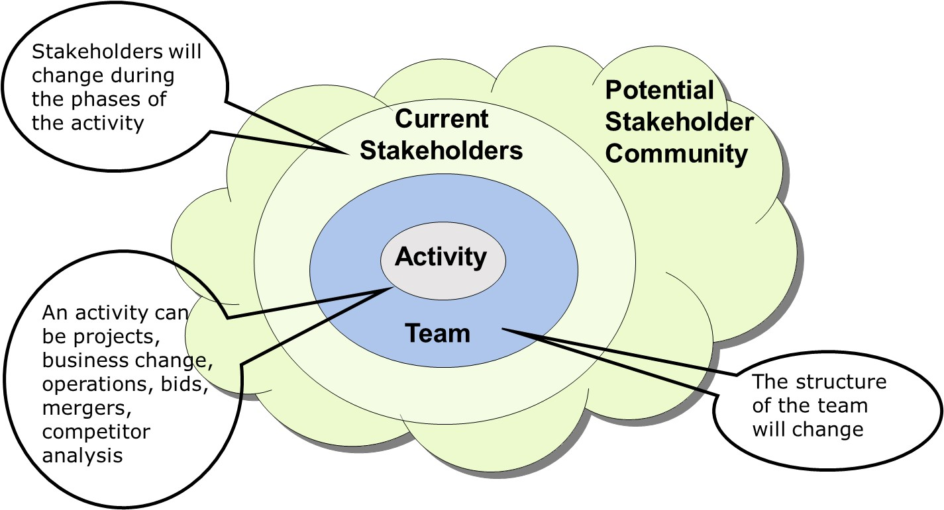
Stakeholder Engagement is Ongoing
Introduction to Accreditation life cycle & stakeholders management
STAKEHOLDERS MANAGEMENT
Continuous improvement is Ongoing
Constitution and formal establishment of permanent “Accreditation Management Committee”, at School of Business / Management Sciences is a promising strategy to deploy quality function in the institution- (for stakeholder engagement and continues involvement)

Slide 16
Introduction to Accreditation life cycle & stakeholders management
NO
Yes
1- Formal Application
3- Eligibility Screening
4- Pre-Review Mentorship
5-Self Assessment Process
6-Peer Review Process
7-Accreditation Decision
2- Pre-Eligibility Mentorship
8-Continuous Review (Re-accreditation/ Revisit
NBEAC RE-ACCREDITATION PROCESS
Post-Accreditation – Continuous Improvement Review
RE-ACCREDITATION :
A process to assess the accomplishments of institution as per PRT report provided at the time of accreditation
IMPROVEMENT & CHANGES sine last PRT visit
The school initiates Re-accreditation process by applying for relevant programmes
Submit current SAR along with CIR (6 months before expiry of Accreditation period)
CIR is an abridged document of AMC proceeding along accreditation period containing:
Improvements as per previous PRT report
Overall Improvements/ Changes on school’s initiatives (Strategic and/or Operational Plan)
The Re-accreditation visit & decision may be communicated as per prevalent policy

